Slide 1
How serious was the Peasants’ Revolt? 1. What happened?
Gut instinct – what is your answer?
Why?
Notes:
Please read the accompanying ‘Teacher resource write-up’ for guidance as to how these lessons work, as well as the historical background knowledge that you need as a teacher.
STORY: Fill in the BLANKS between the end of B.D. and 1381 in terms of POLITICS – i.e. Edward III is dead, grandson Richard II is on the throne but is only ten (perhaps provide a family tree to stick in books) CONTEXT: Give a reminder of the HUNDRED YEARS’ WAR (mentioned in their look at the development of PARLIAMENT) – fill in SOME detail here
DON’T OVERWHELM; the idea is to set up some context so that these threads can be ‘pulled’ as we go through the enquiry.
The starter question leads into two discussions: 1. What’s a revolt? 2. How do we judge ‘serious? Pull out the idea of the peasants too – it’s good to establish what students think of them! Make a note of ‘serious’ points on the whiteboard for later in the lesson.
Please see paper resources lesson 1 document for a worksheet.

Slide 2
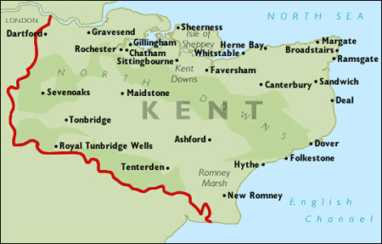
Notes:
March of the Kent rebels. Emphasise the fact that they marched AWAY from London first – what does this tell us about their intentions?
Image: www.britishservices.co.uk/kent.htm

Slide 3
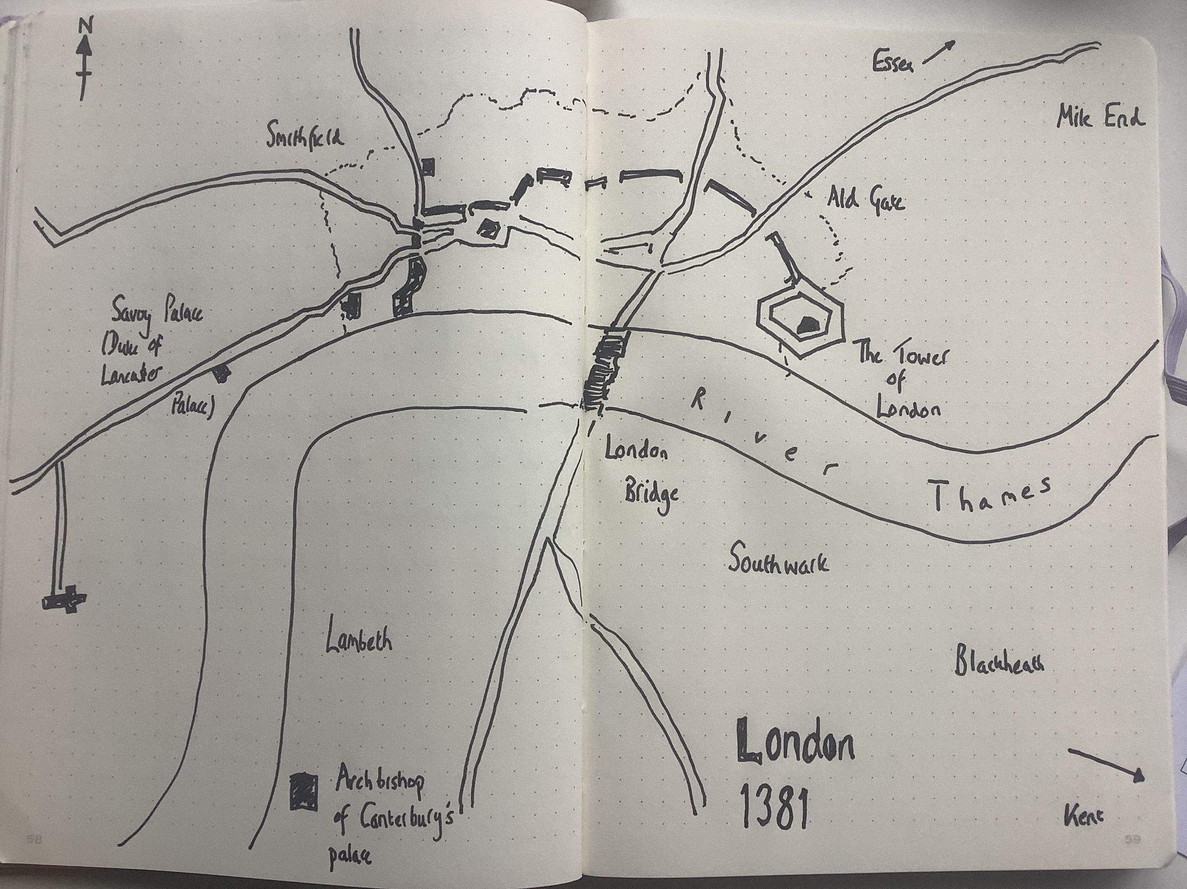
Notes:
LONDON MAP (Andrew Sweet) – context for the source sheet

Slide 4
Tell me the story
Place your timeline cards in the correct chronological order.
Notes:
The timeline cards can be found in ‘paper resources lesson 1’
This is the end of Lesson 1 – an optional extension is on the next slide.

Slide 5
At Brampton, in Essex, Thomas Brampton demanded a new payment of taxes from the people, who said they would not pay a penny more. Thomas ordered the men to be arrested. Then the commons said they had already paid the tax and rose up against him and tried to kill Thomas. Then they went from place to place to stir up other folk.
And at this moment [30 May 1381] a tax collector was sent to Kent, but he was turned back by the commons. And after this the commons of Kent gathered together in great numbers without a head or chieftain and on the Friday [4 June] they came to Rochester. Then they took their way to Maidstone where they made Wat Tyler their chief. And on the Monday next they came to Canterbury. After cutting the heads off three traitors, they took 500 men of the town with them to London, but left the rest to guard the town.
At this time the commons had as their advisor an evil priest called John Ball. A fit reward he got later when he was hung, drawn and quartered. The commons went to many places and gathered 60,000 men. On their way to London they burned the manors of the Duke of Lancaster to the ground because they hated him. When the King [Richard II] heard of these doings he sent his messengers to them asking why they were doing this. And they answered that they had risen up to rescue him from traitors. The King agreed to meet them at Blackheath the next day.
The commons of Kent came to Blackheath and the commons of Essex came to the other side of the water. The King was on his way, but turned back when his advisors warned him not to trust the commons. The commons sent a message asking for the heads of the Duke of Lancaster and the other fifteen lords who ran the government. The commons of Kent came to Southwark and at the same time the commons of Essex came to Lambeth, where they ransacked the buildings of the Archbishop of Canterbury.
The commons of Kent went on to London Bridge to pass into the city. The commons of Southwark rose with them, and forced the guards to lower the drawbridge. The commons from Essex entered through Ald Gate. They came at the Duke of Lancaster’s palace, broke open the gates and burnt all the buildings within the gates. The next day the commons from Kent and Essex met the King at Mile End. They asked that no men should be villeins [serfs]. The King proclaimed that they should be free and pardoned them. The commons from Essex went home, but Wat Tyler with some men then made their way to the Tower where they cut the Archbishop’s head off and paraded it through the streets on wooden poles. That night they murdered some 140 people, and there were hideous cries and horrible tumult all through the night.
The King told all the commons to meet him at Smithfield the next day.
Written by a monk in York in 1399
Highlight the TRIGGER of these events – what sparked the Revolt? (How does this fit in with what we said last term?)
Who were the rebels angry with? How do you know?
Why do you think that this source says that the Essex rebels 'went home' after Mile End? What do you think happened next?
We know that the rebels were summoned to Smithfield – what do you think happened there?
Based on what you’ve just said, how serious do you think this revolt was?
Who wrote this account? How do you think he found out this information?
Does he tell the whole story? Explain your answer (think about who he is…)
When was this account written? How might this have affected what and how the monk tells the story? (What would he KNOW that the people in 1381 would not have known?)
Notes:
OPTIONAL EXTRA: source analysis. Print sheet as handouts for close reading. How much does this tell us about how people in the fourteenth century viewed the Revolt?

Slide 6
How serious was the Peasants’ Revolt? 2. Where did it happen?
SET THE SCENE…
You’re in London; the meeting with Richard II at Mile End has just happened.
I’m a potential rebel from Somerset who happened to be in London on business. Convince me that it’s a good idea to take your ideas back to Somerset and start a rebellion there.
Notes:
This is the start of Lesson 2
REVIEW LAST LESSON: Tell the story, recap ‘serious’ and what it means. MILE END WAS THE TURNING POINT – Richard essentially gave rebels carte blanche to deal with ‘traitors’ (essentially any government official). This meant that the rebels could act (capture, try, murder, confiscate land/money/goods) with impunity. AND THEY HAD IT ON PAPER.

Slide 7
Then:
Use the link on your GoogleClassroom page and annotate five further outbreaks of revolt with the same two questions.
You MUST look at
Yorkshire and
Bridgewater. You may then choose three other events.
For copyright reasons, this image cannot be displayed. Please insert the map image from this link (page 1).
Image: Byrom, J. Counsell, C. and Riley, M. (1997) Medieval Minds: Britain 1066–1500. Longman.
Kent:
Annotate your map.
What did the Kent rebels DO?
Who did they TARGET?
Notes:
Annotate the map. We suggest that Kent is used to model this, as it can be done based on the notes from Lesson 1. Scaffolding can be added/removed as needed.
Image: Byrom, J. Counsell, C. and Riley, M. (1997) Medieval Minds: Britain 1066–1500. Longman.

Slide 8
Can we see any patterns?
1. What patterns can we see?
2. What BIG differences are there?
3. Does this help us to answer our ENQUIRY QUESTION? How SERIOUS was the Revolt?
Complete the second branch of your mind-map – how widespread was the Revolt?
Notes:
Teacher-led discussions. Students can record answers for questions 1 to 3 if needed.
This is the end of Lesson 2.

Slide 9
A question from last lesson… Where did Richard II meet the rebels for the FIRST time? | A question from last week… What TRIGGERED the Peasants’ Revolt?
A question from last term… How could the commons attempt to control the King? | A question from last year… What did William I do when his people rebelled against him?
Notes:
RECALL STARTER for Lesson 3: Discuss answers. Adapt this slide for your own setting.

Slide 10
A question from last lesson… Where did Richard II meet the rebels for the FIRST time? MILE END | A question from last week… What TRIGGERED the Peasants’ Revolt? POLL TAX
A question from last term… How could the commons attempt to control the King? PARLIAMENT (had to grant requests for taxes) | A question from last year… What did William I do when the north rebelled against him in 1087? HARRYING OF THE NORTH (accept ‘general destruction’)

Slide 11
How serious was the Peasants’ Revolt? 3. What did they want?
Right, my lovely bunch of historians.
I want to know where to look to find out what the peasants wanted.
Why might it be HARD to find these answers?
Notes:
This is a nod to procedural problems for the historian: we only have the sources from the SUPPRESSORS – so how do we ‘read’ these to work out what the peasants wanted?
ALSO: Check that students really do ‘get’ what a source is (we bet that at least three or four will say textbooks/Google!).

Slide 12
Why were the peasants angry?
Using your notes from the last couple of lessons, what do YOU think the peasants were angry about?
To answer this question properly, we need to know a little bit more about some of the background to the Revolt.
Complete the research task on your handout. Record the answers to the questions in your exercise books.

Slide 13
Why were the Peasants angry?
Question: Was there someone (whom you’ve already met…) that was involved in ALL of these things?
Who was it?
Knowing what you (now) know about the build-up to the Revolt, are you surprised to find that he was targeted?

Slide 14
Why were the Peasants angry?
Can we now apply the same thinking to ‘find’ some rebel voices?
Look back at your notes from the lesson about where the Revolt happened. What did the peasants DO?
Can we INFER from this what they wanted?
Who did the peasants ATTACK (other than John of Gaunt)? Based on what you now know, can you INFER what these rebels wanted?
What SYMBOLS did the peasants use? Can we learn anything about their motivations from these?
All of the information that we have used to answer these questions has come from the ‘records of POWER’ – the legal records put together by those who suffered damage in the Revolt.
They don’t OPENLY tell us what the peasants wanted. But, by asking slightly different questions and reading between the lines, we’ve been able to work out what the peasants were angry about in 1381.

Slide 15
How serious was the Peasants’ Revolt? 4. Ask the historian
Based on our work over the last few lessons, complete the paragraph at the bottom of your overview sheet.
Notes:
Start of lesson 4
Scaffolding can be added as necessary here – either on the sheet with sentence starters etc, or as a discussion recapping the key events.

Slide 16
Helen Carr
Carr is a medievalist who has written a book on John of Gaunt called The Red Prince.
What does her choice of ‘Prince’ to describe Gaunt in the title of the book reveal about what Carr thinks of him?
We’re going to have a look at what she says about the Peasants’ Revolt today.
Notes:
HANDOUT - Guided reading needed. This slide can be adapted if reading has been set as a homework – run through the answers to the first Qs as a class.

Slide 17
How serious was the Peasants’ Revolt?
Based on your reading, what would Carr say if I asked this question?
Teachmeet History Icons 2022 #tmhi - YouTube
What did she say?
How close were you?
WHY does Carr say this? What REASONS did she give to support her answer?
Notes:
CLIP is at 5:14:50

Slide 18
How serious was the Peasant’s Revolt?
Notes:
BACK TO THE START – have students discuss, articulate and add details to their overview sheet – which can also function as a plan for their essay!

